Slide 1
Amazon Sales Analysis
GROUP NO: 8
Pranay Kothari, 202118010
Bhumi Bosamia, 202118040

Slide 2
PROJECT OVERVIEW
The goal of our project is to analyze and create innovative and interactive dashboards about the sales, categories, products, and shipments of Amazon(B2B) in different countries.
The major problems that we are focusing upon:
Number of Customers, Suppliers, and Orders in different countries
Sales of products according to their category in different years
Year-wise comparison of sales
Revenue Generated by Freight and Total Amount of Products
Analysis of Monthly Orders

Slide 3
DATASET DESCRIPTION
Variable | Description
orderDate | Date on which order has been placed
freight | Shipping Cost
shipCountry | Country in which order needs to be shipped
orderID | Id given to a order
productID | ID if the product ordered
unitPrice | Price of single unit of product
quantity | Quantity of the product ordered
supplierID | ID of the supplier who is supplying the product
categoryID | ID of the category of Product
country | Country of the Supplier
categoryName | Name of the category
productname | Name of the products

Slide 4
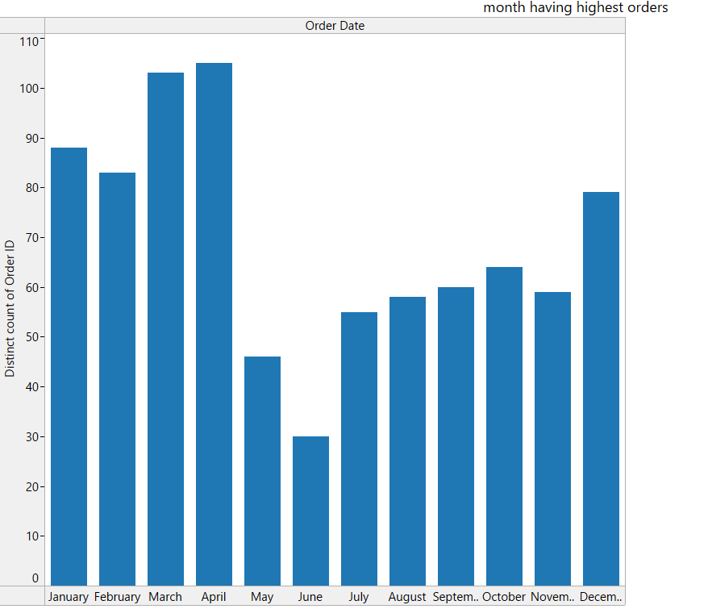
NUMBER OF ORDERS PER MONTH
MARKS: Line
CHANNELS: Positions

Slide 5
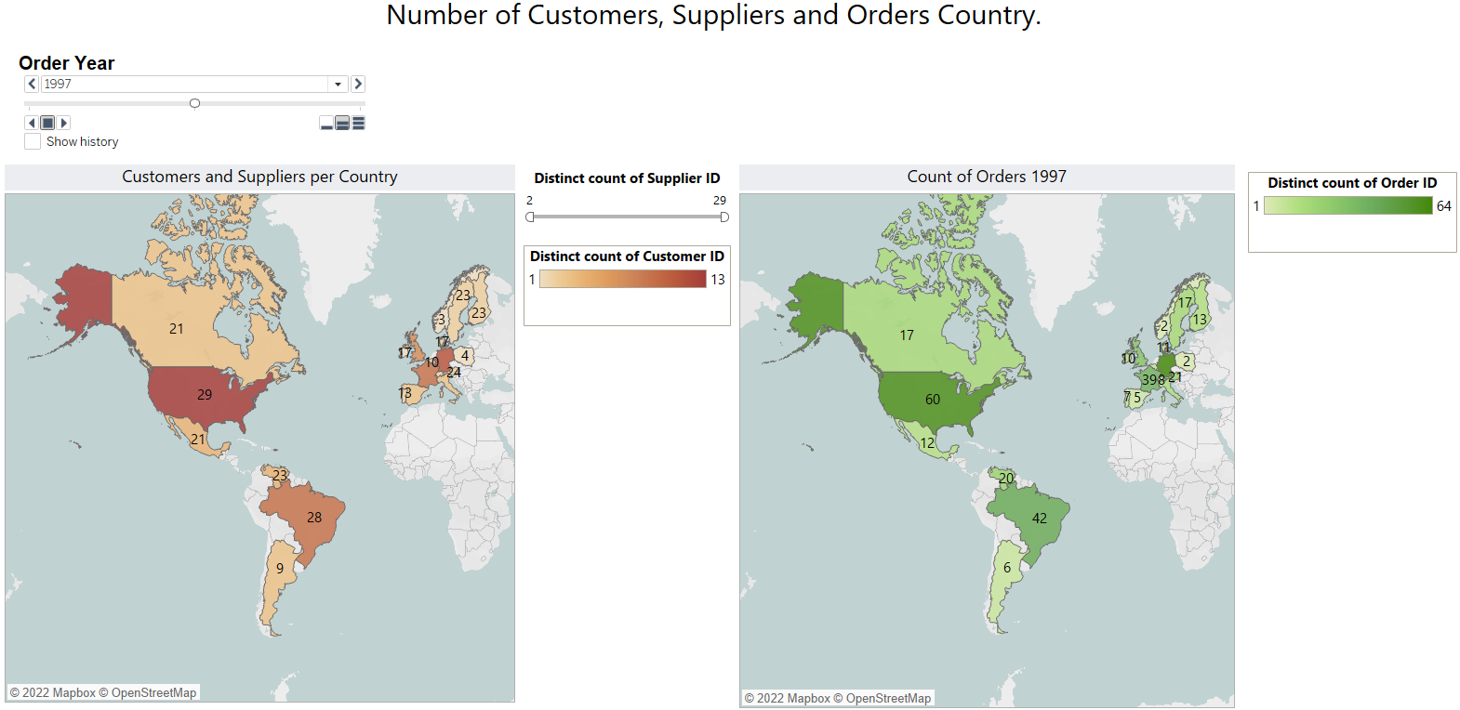
NUMBER OF CUSTOMERS, SUPPLIERS, AND ORDERS IN DIFFERENT COUNTRIES
MARKS: Area
CHANNELS: Color, Spatial Area

Slide 6
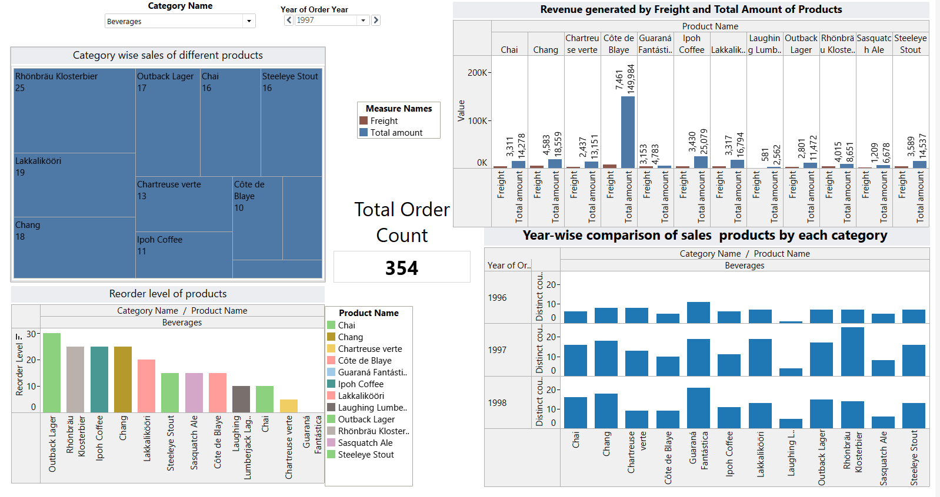
SALES OF PRODUCTS ACCORDING TO THEIR CATEGORY IN DIFFERENT YEARS COUNTRIES
MARKS: Area
CHANNELS: Color
MARKS: Line
CHANNELS: Color, Position

Slide 7
THANK YOU!

